Slide 1
Computer Organization

Slide 2
What is Computer
The term computer has been borrowed from compute that means to calculate.
Computer is an electronic device which is capable of receiving information (data) in a particular form and of performing a sequence of operations in accordance with a predetermined but variable set of procedural instructions (program) to produce a result in the form of information or signals.

Slide 3
Computer Organization:
Design of components and functional blocks using which computer systems are built.
Analogy:Civil Engineer’s task during building construction(cement, bricks, iron rods, and other building materials).
Computer Architecture:
How to integrate these components to build a computer system to achieve a desired level of performance.
Analogy:Architect’s task during the planning of building, layout, floorplan.

Slide 4
History of Computers
Charles Babbage, an English mechanical engineer and polymath, originated the concept of a programmable computer.

Slide 5
First generation computers (1940-1954)
The first generation computers used vacuum tubes for circuitry and magnetic drums for memory.
They were often enormous and taking up entire room.
First generation computers relied on machine language.
They were very expensive to operate and in addition to using a great deal of electricity, generated a lot of heat, which was often the cause of malfunctions.
The UNIVAC and ENIAC computers are examples of first-generation computing devices.
Note: Vacuum tube is a device that controls electric current between electrodes in an evacuated container in a tube.

Slide 6
Advantages
Vacuum tubes were the only electronic component available during those days. • Vacuum tube technology made possible to make electronic digital computers. • These computers could calculate data in millisecond.

Slide 7
Disadvantages
The computers were very large in size. • They consumed a large amount of energy. • Non-portable. • Limited commercial use. • Very slow speed. • Used machine language only. • Used magnetic drums which provide very less data storage.

Slide 8
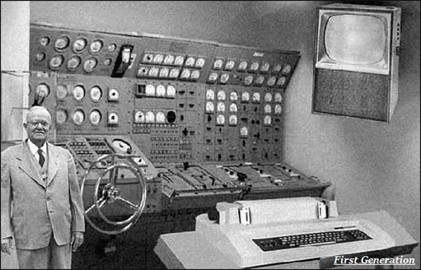
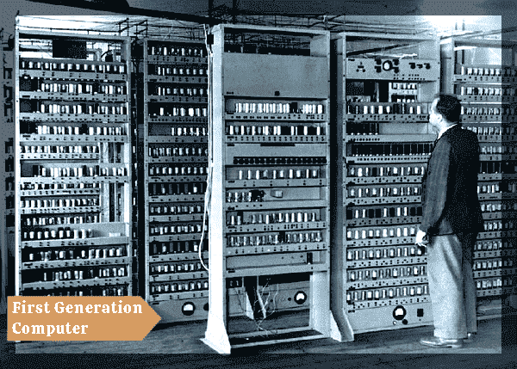

Slide 9
Second generation computers (1955-1964
• Transistors replaced vacuum tubes and ushered in the second generation of computers
• Second-generation computers moved from cryptic binary machine language to symbolic.
• High-level programming languages were also being developed at this time, such as early versions of COBOL and FORTRAN.
• These were also the first computers that stored their instructions in their memory.

Slide 10
Advantages :
Smaller in size as compared to the first generation computers. • Used less energy and were not heated. • Better speed and could calculate data in microseconds • Used faster peripherals like tape drives, magnetic disks, printer etc. • Used Assembly language instead of machine language.

Slide 11
Disadvantages
Cooling system was required
Costly and not versatile
Constant maintenance was required
Only used for specific purposes

Slide 12
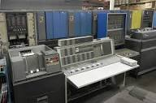
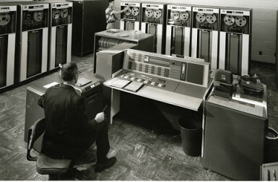

Slide 13
Third generation computers (1965-1974)
The development of the integrated circuit was the hallmark of the third generation of computers.
Transistors were miniaturized and placed on siliconchips, called semiconductors.
Instead of punched cards and printouts, users interacted with third generation computers through keyboards and monitors and interfaced with an operating system.
Allowed the device to run many different applications at one time.

Slide 14
An integrated circuit (IC), sometimes called a chip or microchip, is a semiconductor wafer on which thousands or millions of tiny resistors, capacitors, and transistors are fabricated.

Slide 15
Advantages
Smaller in size as compared to previous generations. • More reliable. • Used less energy. • Better speed and could calculate data in nanoseconds.
Disadvantages
Air conditioning was required.
Highly sophisticated technology required for the manufacturing of IC chips.

Slide 16
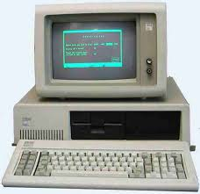

Slide 17
Fourth generation computers (1975-1984)
The microprocessor brought the fourth generation of computers, as thousands of integrated circuits were built onto a single silicon chip.
The Intel 4004 chip, developed in 1971, located all the components of the computer.
From the central processing unit and memory to input/output controls—on a single chip.
Fourth generation computers also saw the development of GUIs, the mouse and handheld devices.

Slide 18
The fourth generation computers started with the invention of Microprocessor. The Microprocessor contains thousands of ICs. The LSI (Large Scale Integration) circuit and VLSI (Very Large Scale Integration) circuit was designed.

Slide 19
Advantages :
More powerful and reliable than previous generations. • Small in size • Fast processing power with less power consumption • Fan for heat discharging and thus to keep cold. • Cheapest among all generations • All types of High level languages can be used in this type of computers

Slide 20
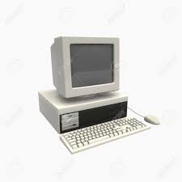

Slide 21
Fifth generation computers (1984-1990)
Fifth generation computing devices, based on artificial intelligence.
Are still in development, though there are some applications, such as voice recognition.
The use of parallel processing and superconductors is helping to make artificial intelligence a reality.
The goal of fifth-generation computing is to develop devices that respond to natural language input and are capable of learning and self-organization.

Slide 22
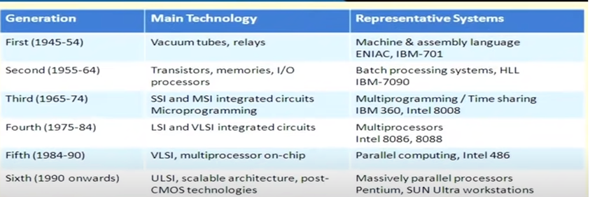

Slide 23
First Generation (1940s-1950s): Vacuum tube-based computers.
Second Generation (1950s-1960s): Transistor-based computers, smaller and more reliable than vacuum tube computers.
Third Generation (1960s-1970s): Integrated circuits (ICs) replaced transistors, leading to more powerful and efficient computers.
Fourth Generation (1970s-1980s): Introduction of microprocessors, which further miniaturized and improved computer performance.

Slide 24
Fifth Generation (1980s-1990s): Advancements in parallel processing, artificial intelligence, and high-level languages.
Sixth Generation (1990s-present): Focus on parallel processing and integration of AI technologies.
Seventh Generation (Present): Focus on cloud computing, mobile devices, and further advancements in AI and machine learning.

Slide 25
The generation of computer represents the broader stages of technological advancement in computer history.
while the generation of processor denotes the specific iterations or versions of a particular CPU family released by the manufacturer.

Slide 26
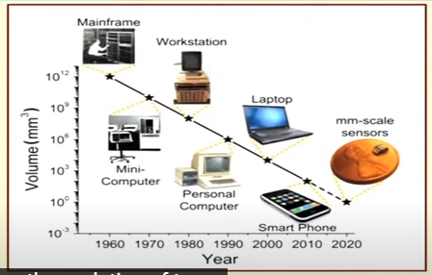
Milimeter scale sensors: These sensors are used to sense the data, process it and communicate also.

Slide 27
Future:
Large scale IOT based systems.
Wearable computing
Intelligent Objects.

Slide 28
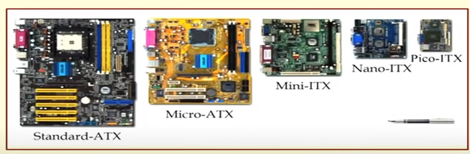
Evolution of PC form factors over the years

Slide 29
Today’s
Miniaturization in feature sizes of all parts.
Hard drive getting replaced by flash based memory devices.
Cooling is major issue.

Slide 30
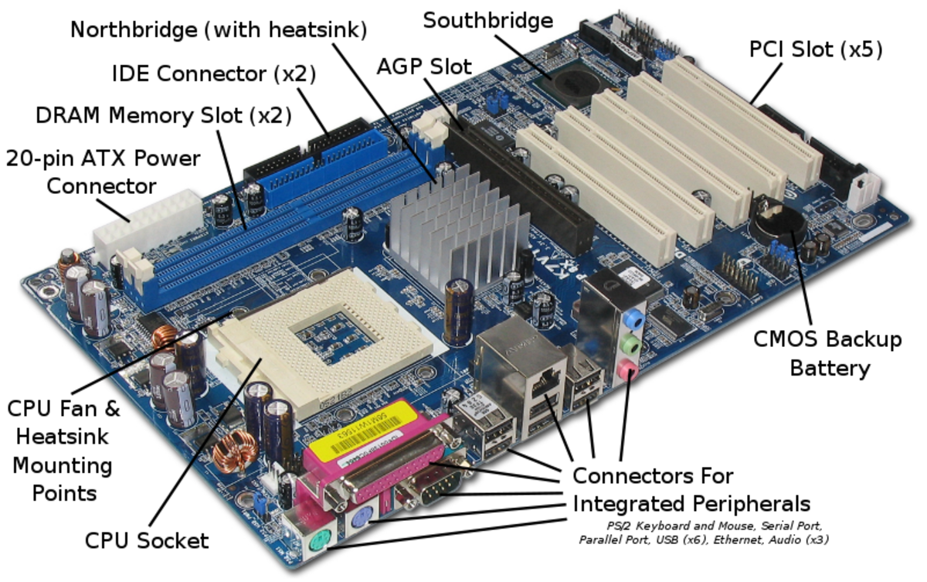

Slide 31
A PCI slot is a built-in slot on a device that allows for the attachment of various hardware components such as network cards, modems, sound cards, disk controllers and other peripherals.
The CMOS battery powers your laptop's BIOS firmware, which is responsible for booting up your computer and configuring data flow. You can tell if your CMOS battery has died if your laptop has difficult booting up, if drivers disappear, and if your laptop's date and time are incorrect.

Slide 32
An Accelerated Graphics Port (AGP) is a point to point channel that is used for high-speed video output.
This port is used to connect graphic cards to a computer's motherboard.

Slide 33
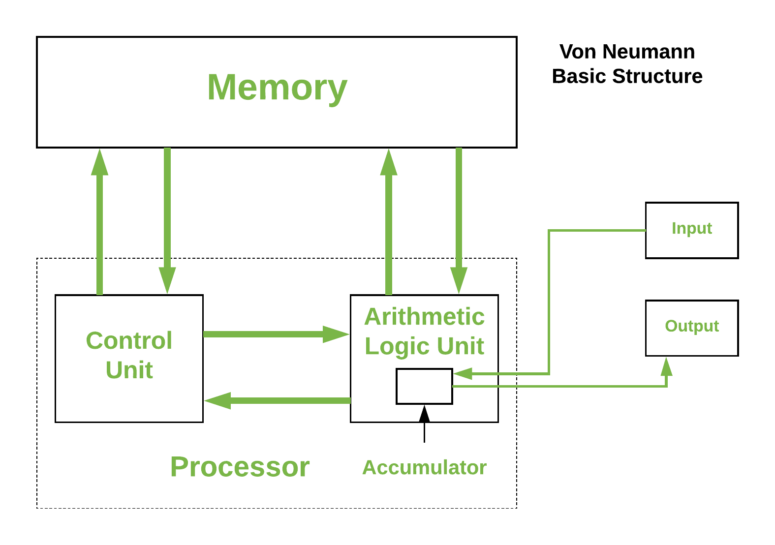
Von-Neumann Architecture

Slide 34
Control Unit – A control unit (CU) handles all processor control signals. It directs all input and output flow, fetches code for instructions, and controls how data moves around the system.
Arithmetic and Logic Unit (ALU) – The arithmetic logic unit is that part of the CPU that handles all the calculations the CPU may need, e.g. Addition, Subtraction, Comparisons. It performs Logical Operations, Bit Shifting Operations, and Arithmetic operations.

Slide 35
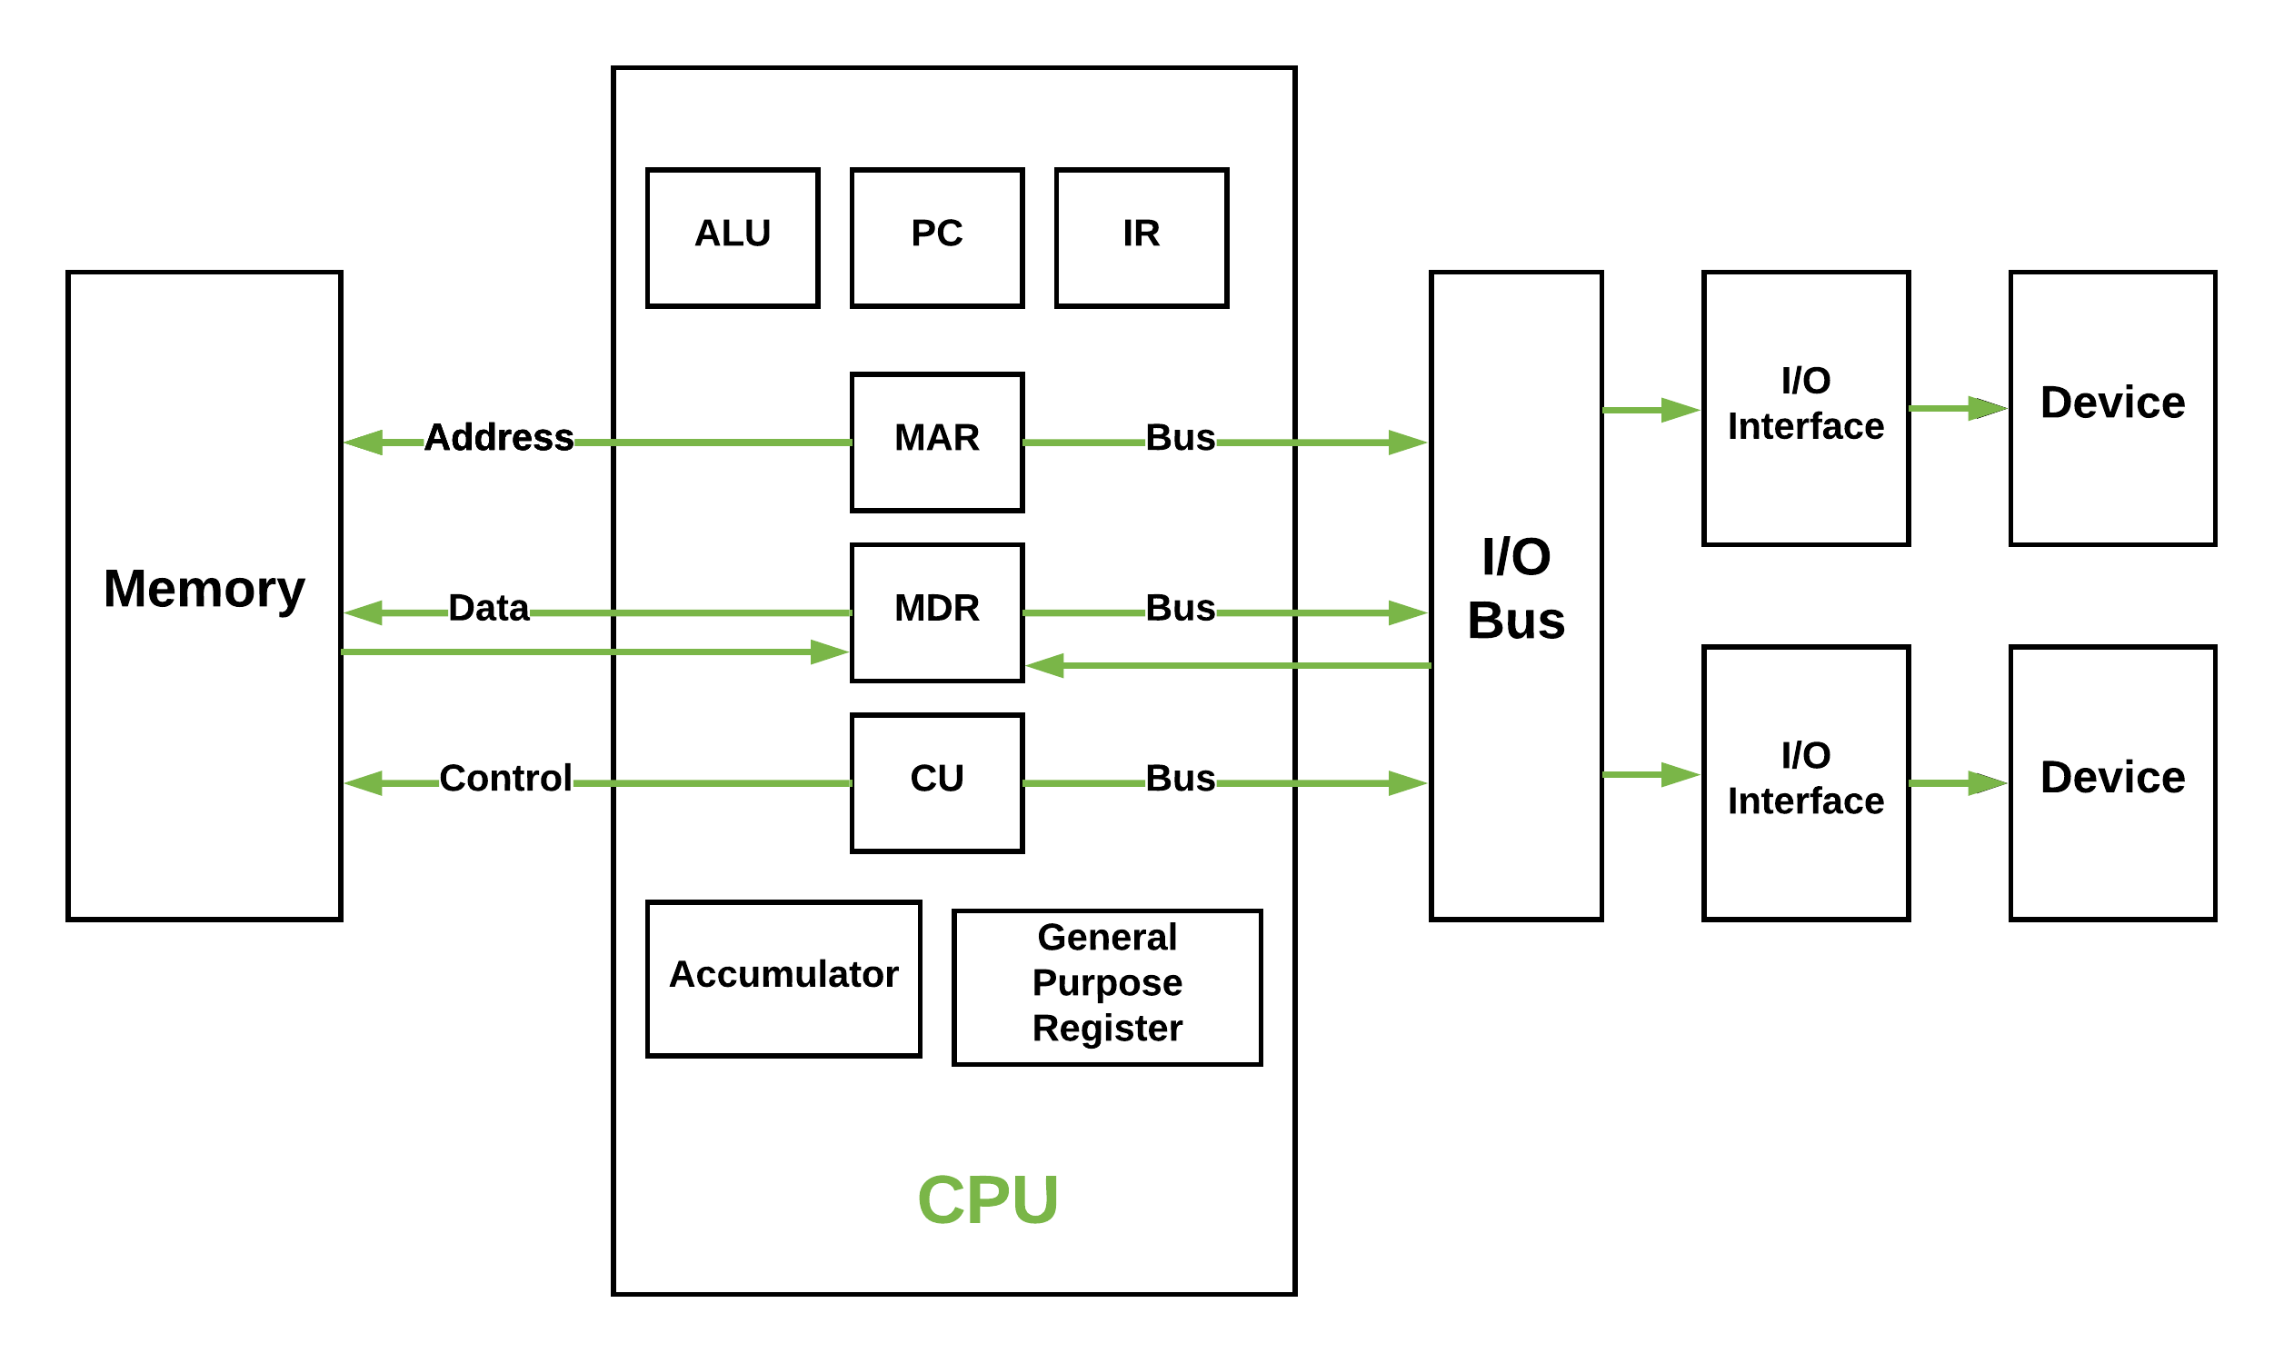
Inside Architecture of Processor

Slide 36
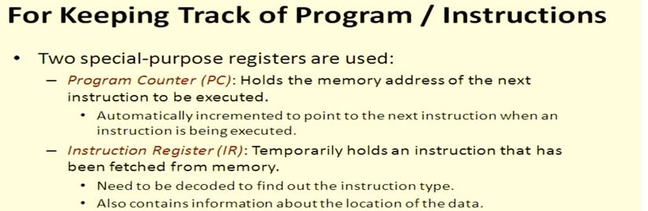

Slide 37
Main Memory Unit (Registers) –
Accumulator: Stores the results of calculations made by ALU.
Program Counter (PC): Keeps track of the memory location of the next instructions to be dealt with. The PC then passes this next address to Memory Address Register (MAR).
Memory Address Register (MAR): It stores the memory locations of instructions that need to be fetched from memory or stored into memory.
Memory Data Register (MDR): It stores instructions fetched from memory or any data that is to be transferred to, and stored in, memory.
Current Instruction Register (CIR): It stores the most recently fetched instructions while it is waiting to be coded and executed.
Instruction Buffer Register (IBR): The instruction that is not to be executed immediately is placed in the instruction buffer register IBR.

Slide 38
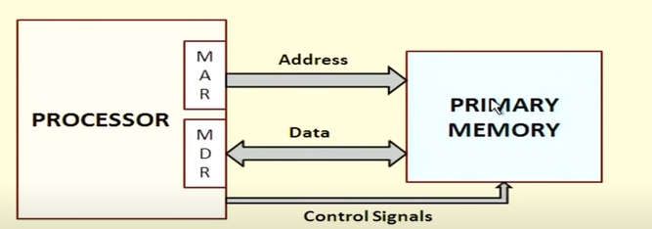

Slide 39
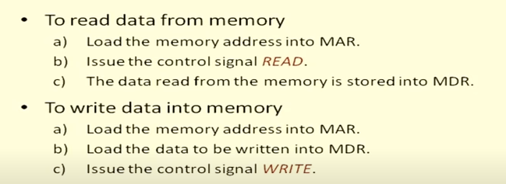

Slide 40
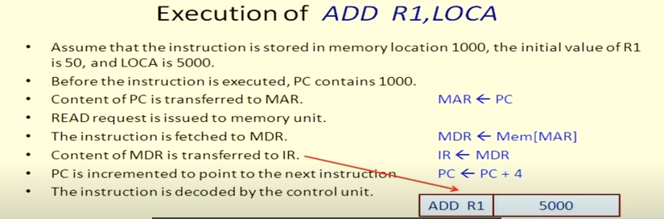

Slide 41
Buses – Data is transmitted from one part of a computer to another, connecting all major internal components to the CPU and memory, by the means of Buses. Types:
Data Bus: It carries data among the memory unit, the I/O devices, and the processor.
Address Bus: It carries the address of data (not the actual data) between memory and processor.
Control Bus: It carries control commands from the CPU (and status signals from other devices) in order to control and coordinate all the activities within the computer.

Slide 42
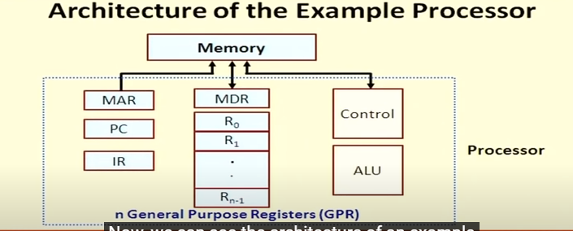

Slide 43
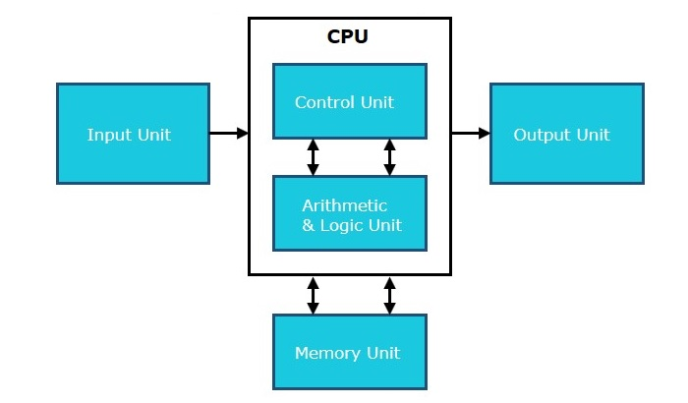
Computer Component

Slide 44
Input Unit
This unit contains devices with the help of which we enter data into the computer. This unit creates a link between the user and the computer.

Slide 45
CPU (Central Processing Unit)
CPU is considered as the brain of the computer. CPU performs all types of data processing operations. It stores data, intermediate results, and instructions (program). It controls the operation of all parts of the computer.
CPU itself has the following components −
ALU (Arithmetic Logic Unit)
Control Unit

Slide 46
Output Unit
The output unit consists of devices with the help of which we get the information from the computer. This unit is a link between the computer and the users.

Slide 47
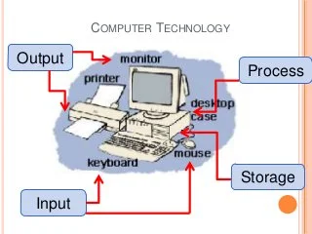

Slide 48
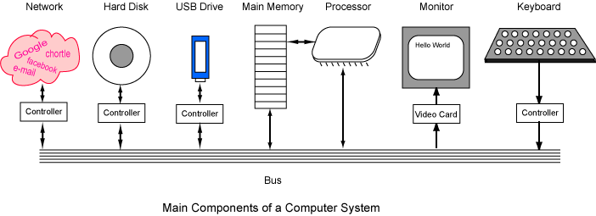

Slide 49
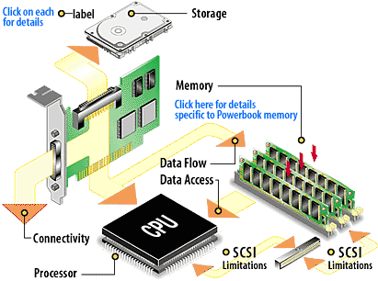

Slide 50
Bus Structure
A Bus is said to be group of lines that serves as a connecting path for several devices .
In addition to the lines that carry the data, the bus must have lines for address and control purposes.

Slide 52
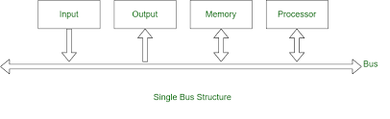
Single Bus Structure

Slide 53
In a single bus structure, one common bus is used to communicate between peripherals and microprocessors. It has disadvantages due to the use of one common bus.
Because the bus can be used for only one transfer at a time,
only two units can actively use the bus at any given time.
Bus control lines are used to arbitrate multiple requests for use of the bus.
The main virtue of the single-bus structure is its low cost and is flexibility for attaching peripheral" devices.

Slide 54
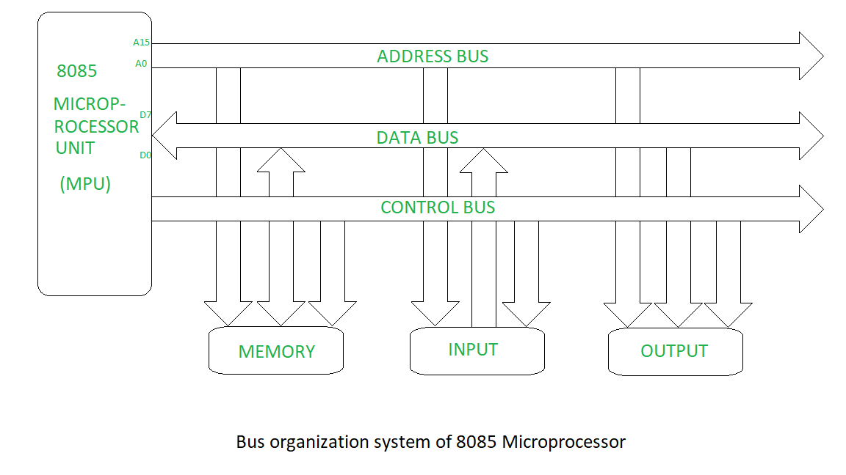
Bus Structure with different buses

Slide 55
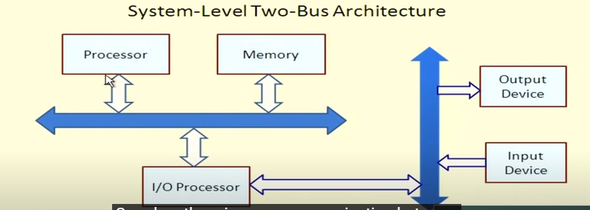

Slide 56
Systems that contain multiple buses achieve more concurrency in operations by allowing two or more transfers to be carried out at the same time.
This leads to better performance but at an increased cost.

Slide 57
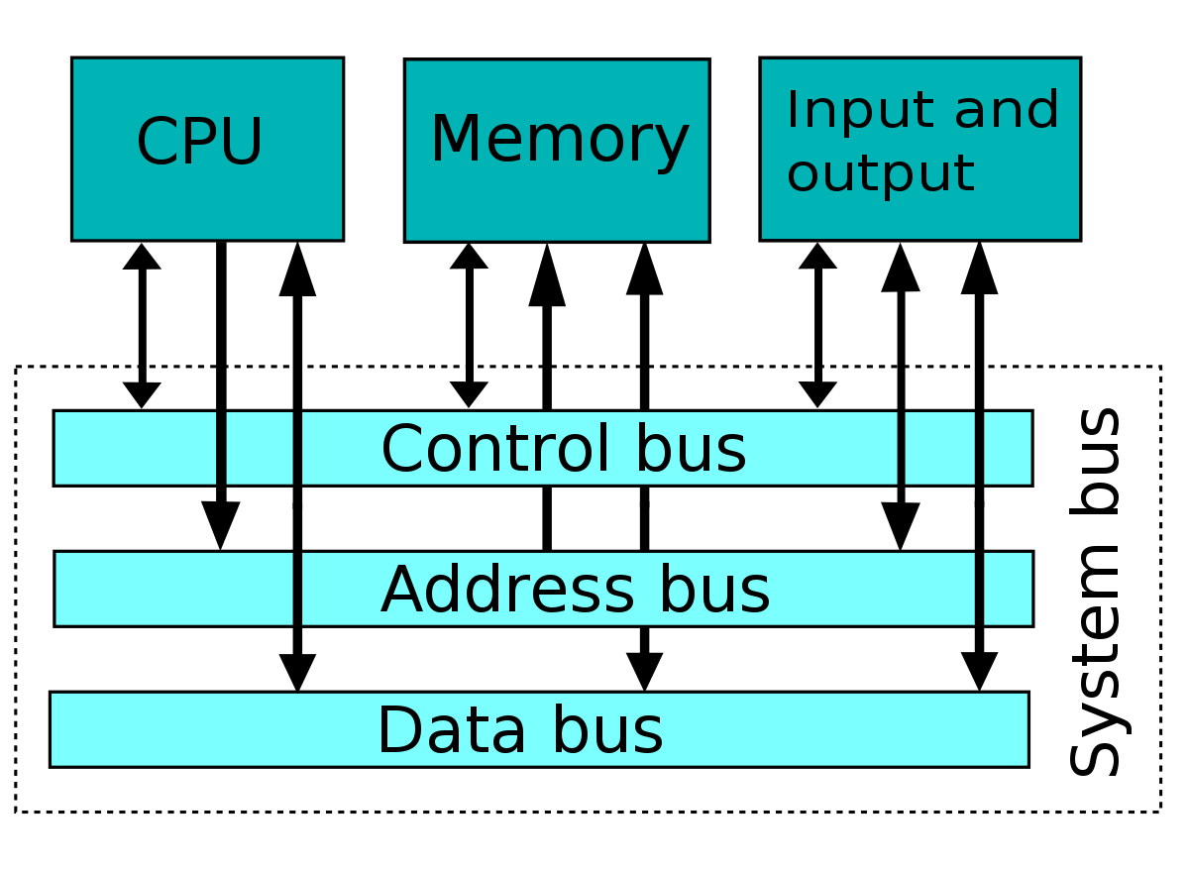

Slide 58
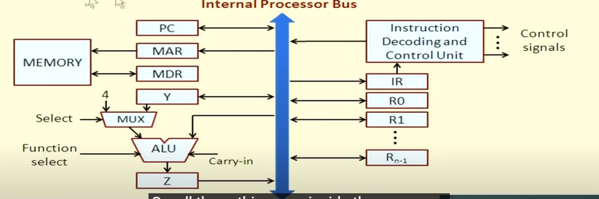

Slide 59
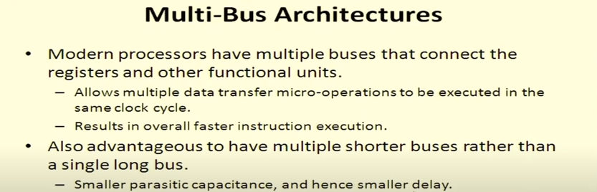

Slide 60
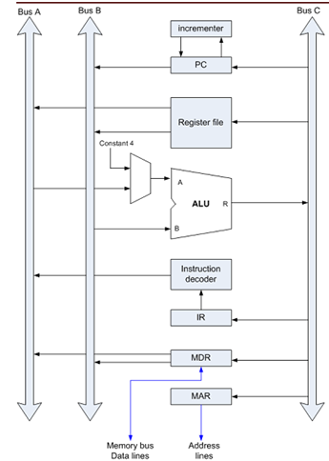
Multiple Bus Architecture inside the processor

Slide 61
Signed and unsigned Numbers
Variables such as integers can be represent in two ways, i.e., signed and unsigned.
Signed numbers use sign flag or can be distinguish between negative values and positive values.
Whereas unsigned numbers stored only positive numbers but not negative numbers.

Slide 62
We represent the positive numbers without adding any sign before them and the negative number with - (minus) sign before them.
But in the digital system, it is not possible to use negative sign before them because the data is in binary form in digital computers.
For representing the sign in binary numbers, we require a special notation.

Slide 63
The signed numbers have a sign bit so that it can differentiate positive and negative integer numbers.
The signed binary number technique has both the sign bit and the magnitude of the number. For representing the negative decimal number, the corresponding symbol in front of the binary number will be added.

Slide 64
There are the following types of representation of signed binary numbers:
Sign-Magnitude form In this form, a binary number has a bit for a sign symbol. If this bit is set to 1, the number will be negative else the number will be positive if it is set to 0. Apart from this sign-bit, the n-1 bits represent the magnitude of the number.
1's Complement By inverting each bit of a number, we can obtain the 1's complement of a number. The negative numbers can be represented in the form of 1's complement. In this form, the binary number also has an extra bit for sign representation as a sign-magnitude form.

Slide 65
2's Complement By inverting each bit of a number and adding plus 1 to its least significant bit, we can obtain the 2's complement of a number. The negative numbers can also be represented in the form of 2's complement. In this form, the binary number also has an extra bit for sign representation as a sign-magnitude form.

Slide 66
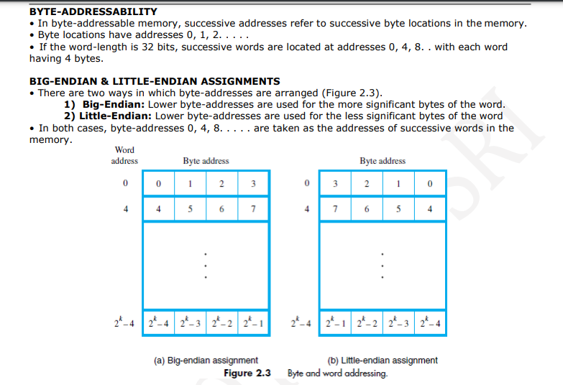

Slide 67
